Slide 1
COA
Introduction and Performance of Computing system

Slide 2
Computer Architecture & Organization
Computer architecture refers to those attributes of a system visible to a programmer or, put another way, those attributes that have a direct impact on the logical execution of a program.
Computer organization refers to the operational units and their interconnections that realize the architectural specifications.

Slide 3
Examples of architectural attributes include the instruction set, the number of bits used to represent various data types (e.g., numbers, characters), I/O mechanisms, and techniques for addressing memory.
Organizational attributes include those hardware details transparent to the programmer, such as control signals; interfaces between the computer and peripherals; and the memory technology used.

Slide 4
A computer is a complex system
A hierarchical system is a set of interrelated subsystems
At each level, the designer is concerned with structure and function:
• Structure: The way in which the components are interrelated
• Function: The operation of each individual component as part of the structure

Slide 5
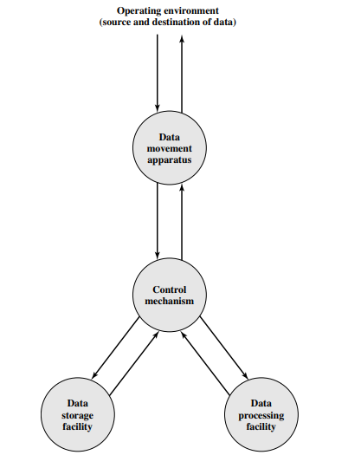
Functional View of the Computer
Data processing
• Data storage
• Data movement
• Control

Slide 6
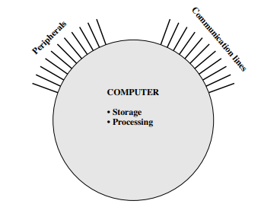
Structure of a Computer
All of computers linkages to the external environment can be classified as peripheral devices or communication lines.

Slide 7
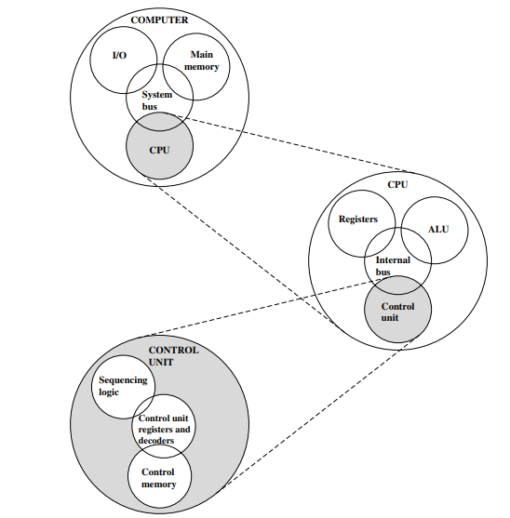
The Computer: Top-Level Structure

Slide 8
Four main structural components
Central processing unit (CPU): Controls the operation of the computer and performs its data processing functions; often simply referred to as processor.
Main memory: Stores data.
I/O: Moves data between the computer and its external environment.
System interconnection: Some mechanism that provides for communication among CPU, main memory, and I/O. An example is interconnection by means of a system bus, consisting of a number of conducting wires to which all the other components attach.

Slide 9
Major structural components of CPU are as follows:
• Control unit: Controls the operation of the CPU and hence the computer
• Arithmetic and logic unit (ALU): Performs the computer’s data processing functions
• Registers: Provides storage internal to the CPU
• CPU interconnection: Some mechanism that provides for communication among the control unit, ALU, and registers

Slide 10
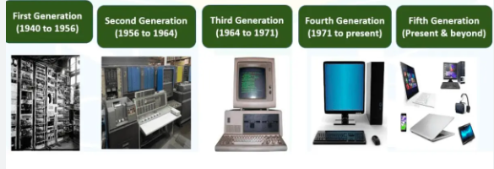
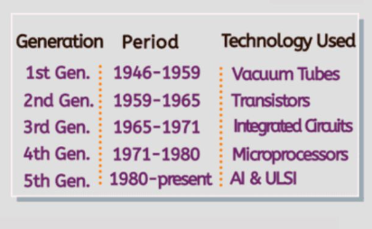
HISTORY of Computers

Slide 11
The evolution of computers has been characterized by increasing processor speed, decreasing component size, increasing memory size, and increasing I/O capacity and speed
Speed in recent years have come from the organization of the processor, including heavy use of pipelining and parallel execution techniques
A critical issue in computer system design is balancing the performance of the various elements so that gains in performance in one area are not handicapped by a lag in other areas (processor speed is rapidly increased than memory access time)
To overcome the mismatch - caches, wider data paths from memory to processor, and more intelligent memory chips are used

Slide 12
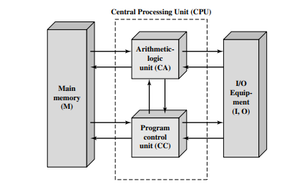
With rare exceptions, all of today’s computers have this same general structure and function and are thus referred to as Von Neumann machines.
Notes:
A main memory, which stores both data and instructions
An arithmetic and logic unit (ALU) capable of operating on binary data
A control unit, which interprets the instructions in memory and causes them to be executed
Input and output (I/O) equipment operated by the control unit

Slide 13
Memory
The memory of the IAS consists of 1000 storage locations, called words, of 40 binary digits (bits) each.
Both data and instructions are stored there. Numbers are represented in binary form, and each instruction is a binary code.
Each number is represented by a sign bit and a 39-bit value.
A word may also contain two 20-bit instructions, with each instruction consisting of an 8-bit operation code (opcode) specifying the operation to be performed and a 12-bit address designating one of the words in memory (numbered from 0 to 999)

Slide 14
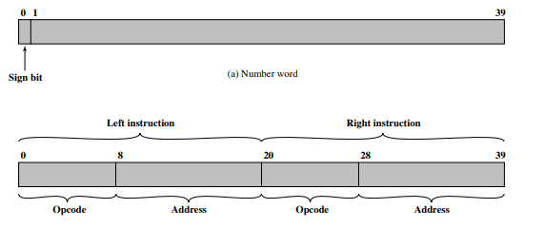

Slide 15
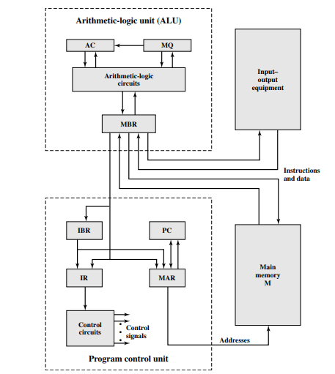
Expanded Structure of Computer

Slide 16
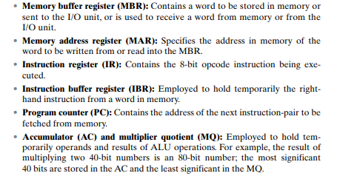

Slide 17
Instruction cycle
Each instruction cycle consists of two subcycles.
Fetch cycle - the opcode of the next instruction is loaded into the IR and the address portion is loaded into the MAR. This instruction may be taken from the IBR, or it can be obtained from memory by loading a word into the MBR, and then down to the IBR, IR, and MAR.
Once the opcode is in the IR, the execute cycle is performed. Control circuitry interprets the opcode and executes the instruction by sending out the appropriate control signals to cause data to be moved or an operation to be performed by the ALU

